Slide 1
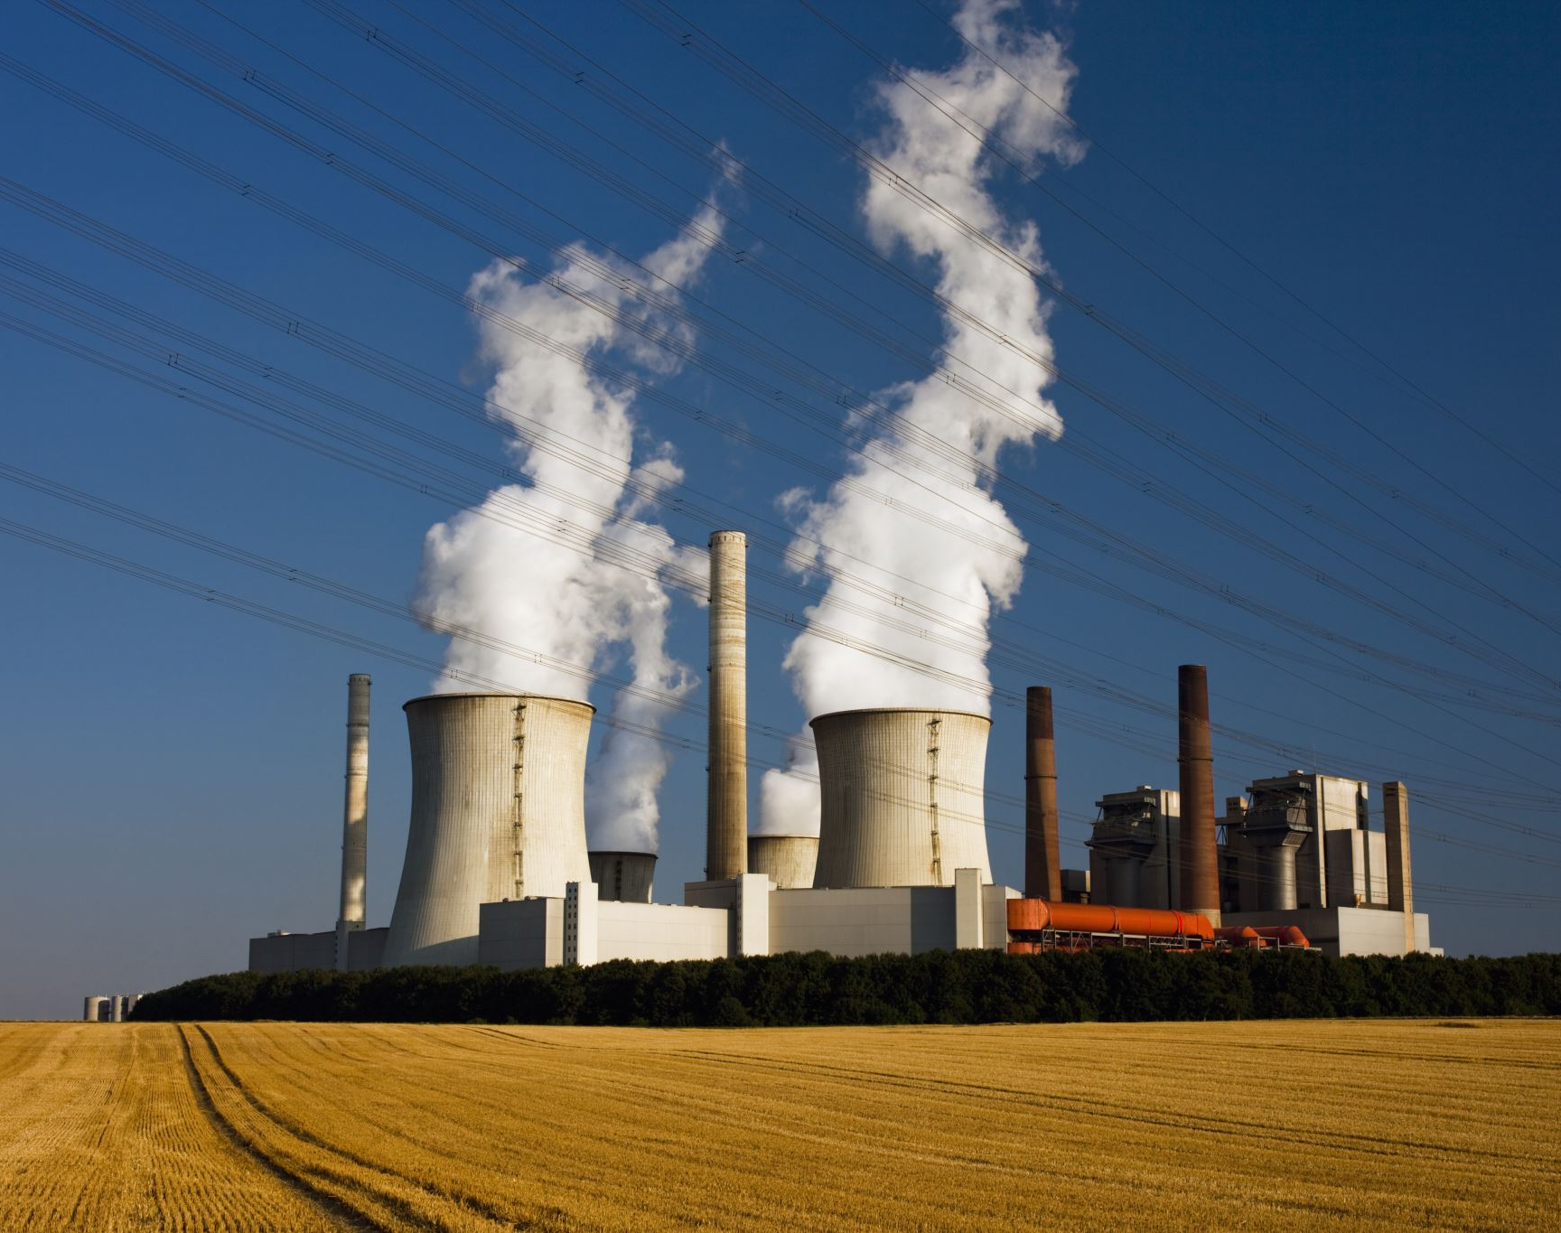
Energy sources and Impact
Ironhack 08/2022
Project W5
Ignace GRAVEREAUX

Slide 2
Content
Data sources & Data Frame
Problem statement & Main takeaway
Linear Model & Comparison to reality
Data Vizualisation & Analysis
Conclusion & Future prospects

Slide 3
Data sources & Data Frame
Origine :
  Hannah Ritchie and Max Roser (2021) – Energy. Published in Our World in Data. Online at: ourworldindata.org/energy
Rows :
  152 countries + years (1900-2020)
  32 aggregated territories (useless, poorly filled) : USSR, East Africa, Low-income, …
Columns
  128 measures
  Input :
    Population, GDP
    Added : GDP per capita / C02 per capita / C02 per GDP
    Source of primary energies : Fossil energy // Renewable + Nuclear
  Output
    Million tons of CO2 equivalent

Slide 4
Problem statement & Main takeaway
Context:
  Global warming is a long-lasting phenomenon and current scientific knowledge indicates that the increase in temperature is correlated with the emission of C02
Scope :
  Countries with high enough GDP and no missing values
  Year : 2000-2018
  Global energy consumption : electricity + transport + heating
  Energies Unit : equivalent TWH
Problem statement:
  What are the main primary energy sources that release C02 into the atmosphere?
  What are the main continent/country responsable of C02 emission?
Main takeaway:
  Coal is the main source of C02, followed by oil and both can explain 80% of the increase in C02 emissions
  Asia (China in top) is by far the main responsable
  There will be no global decline in C02 emissions in near future

Slide 5
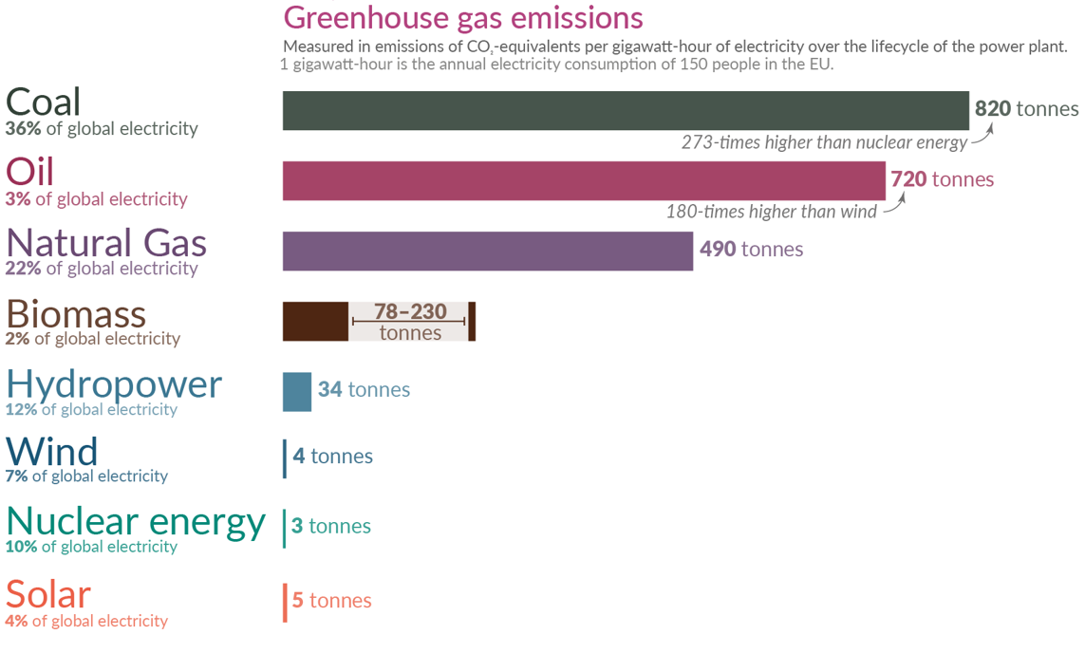
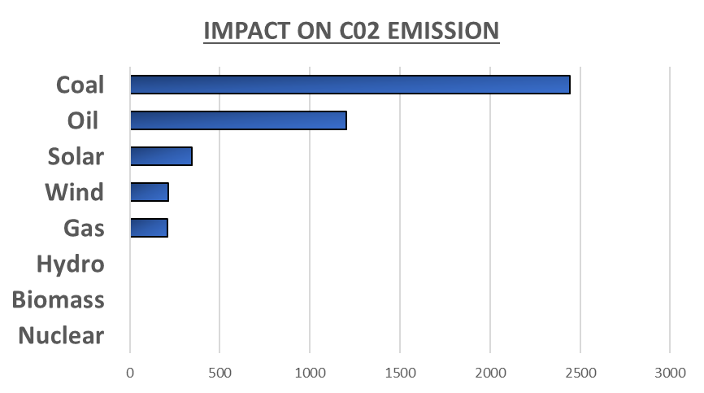
Linear Model & Comparison to reality
Results Linear Model
Real data
Data
Input : Coal, Oil, Gas // Nuclear, Biofuel, Hydro, Wind, Solar
Output : Million of tons of C02 equivalent emissions
Results
R2 score of trained and test dataset are 98,8%
MAPE train and test dataset are 2.6% / 1,7%

Slide 6
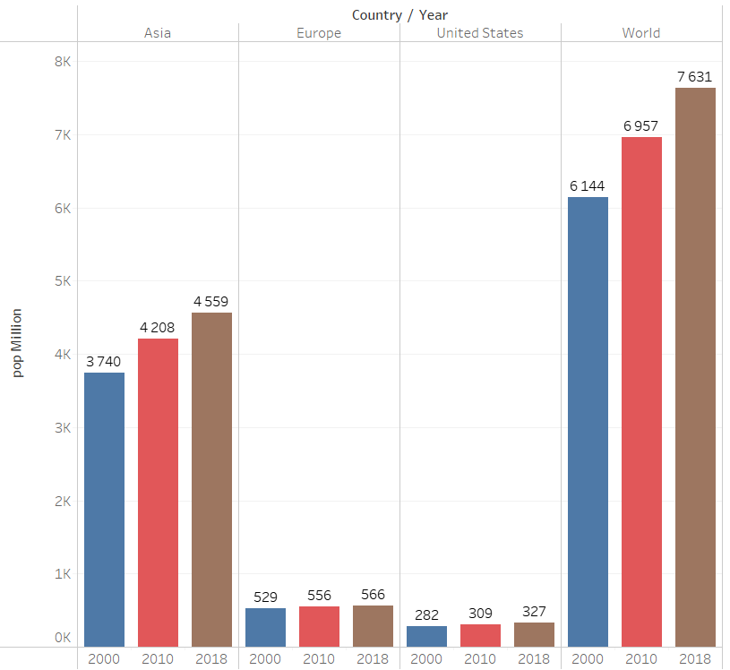
Data Vizualisation & Analysis
Population in Asia/Europe/USA in 2000/2010/2018
Population
 | Value | Trend
Asia | ++ | ++
Europe | - | - +
Usa | - | - +
World | +++ | +++

Slide 7
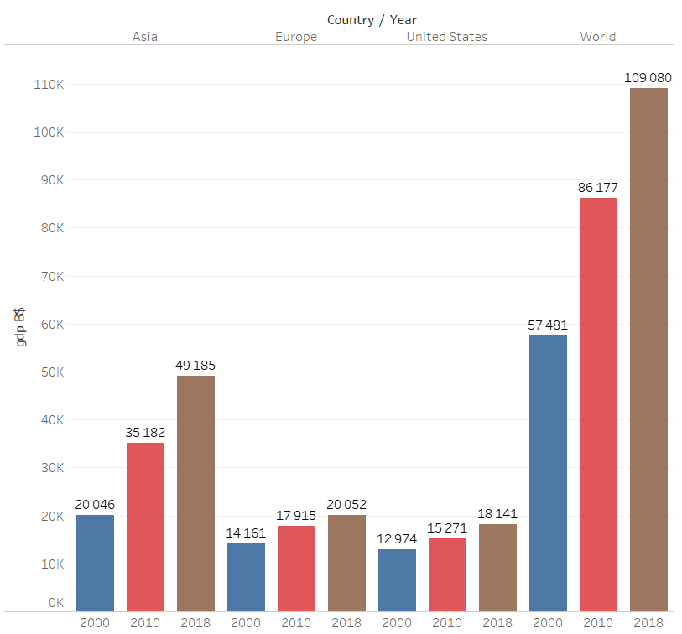
Data Vizualisation & Analysis
GDP in B$ in Asia/Europe/USA in 2000/2010/2018
GDP in B$
 | Value | Trend
Asia | +++ | +++
Europe | ++ | +
Usa | ++ | +
World | ++++ | ++++

Slide 8
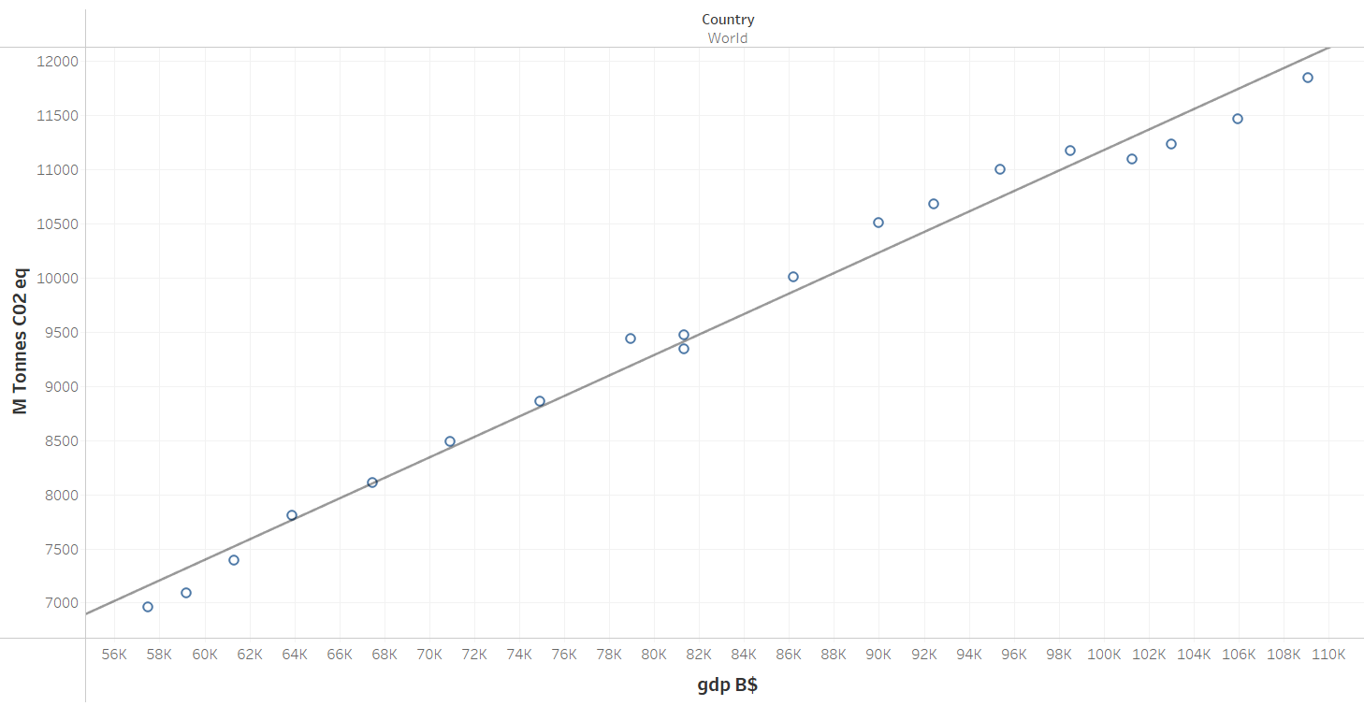
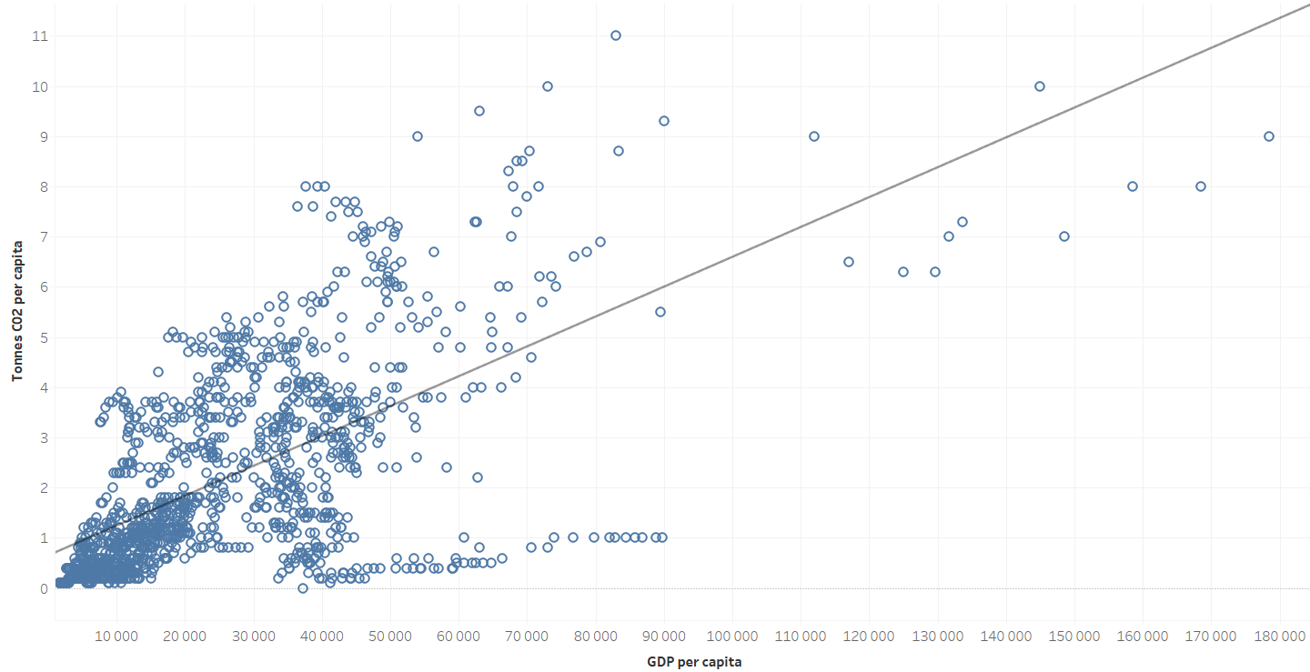
Data Vizualisation & Analysis
C02 Emissions versus GDP from 2000 to 2018
High correlation between wealth and C02 emission
C02 emission in continuous growth from 2000 to 2018
World trend
Correlation between :
  C02 emission per capita
  GDP per capita
=> The richer you are, the more C02 you release
Per capita

Slide 9
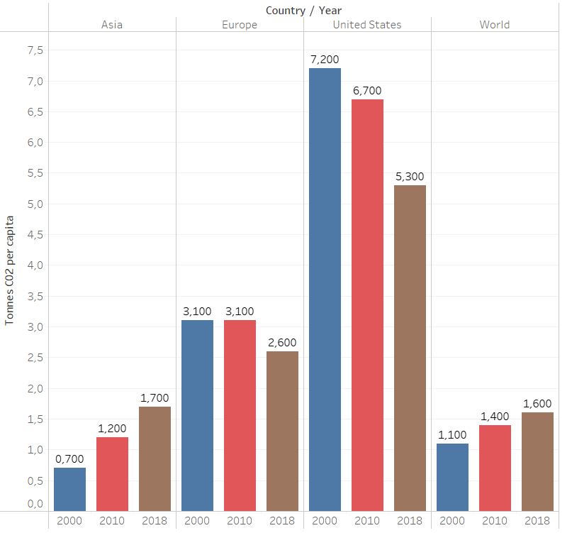
Data Vizualisation & Analysis
C02 Emissions per capita: in Asia/Europe/USA in 2000/2020/2018
C02 EMISSIONS per capita
 | Value | Trend
Asia | + | +++
Europe | ++ | - -
Usa | +++ | - - -
World | + | ++

Slide 10
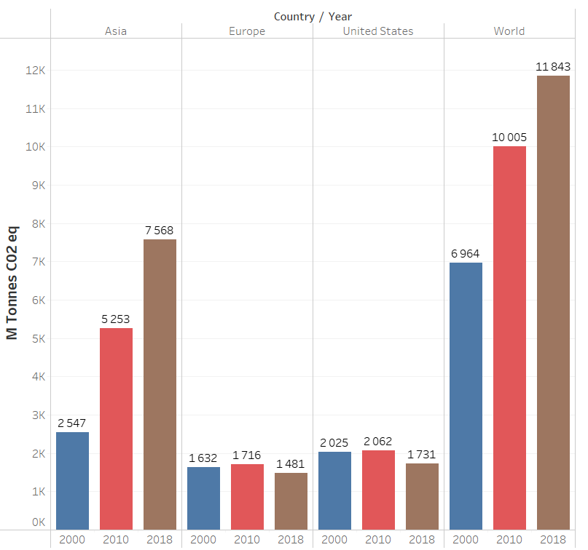
Data Vizualisation & Analysis
C02 Emissions in Asia/Europe/USA in 2000/2010/2018
C02 EMISSIONS
 | Value | Trend
Asia | ++ | +++
Europe | + | -
Usa | + | -
World | ++ | +++

Slide 11
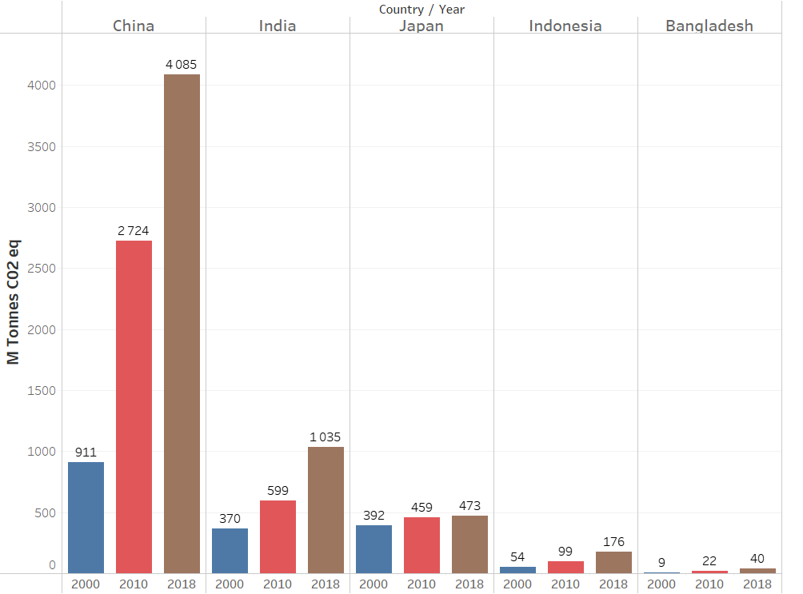
Data Vizualisation & Analysis
C02 Emissions in Asia in 2000/2010/2018
C02 EMISSIONS in Asia
 | Value | Trend
China | +++ | +++
India | + | +++
Japon | + | +
Indonesia | + | +++

Slide 12
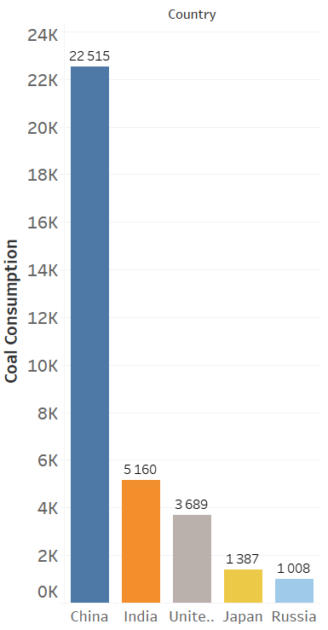
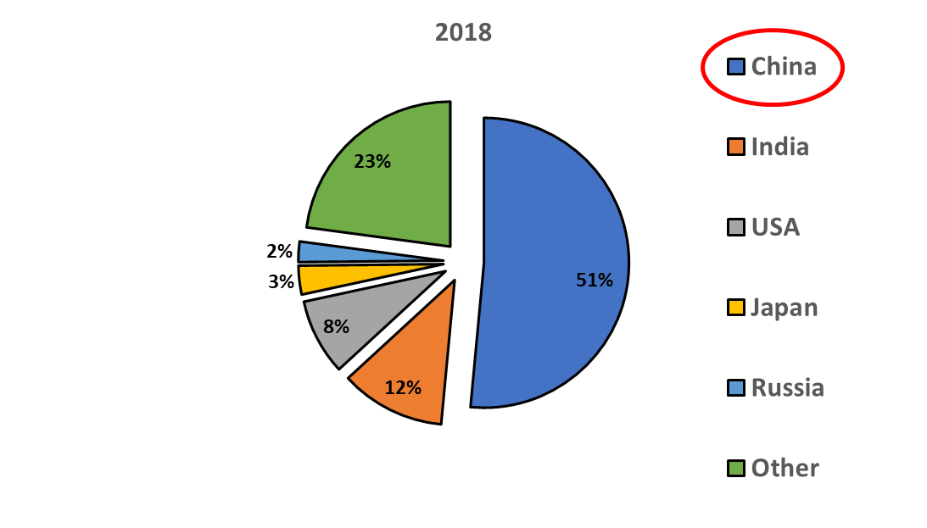
Data Vizualisation & Analysis
Coal Consumption per country in 2018 (in eq. TWH)

Slide 13
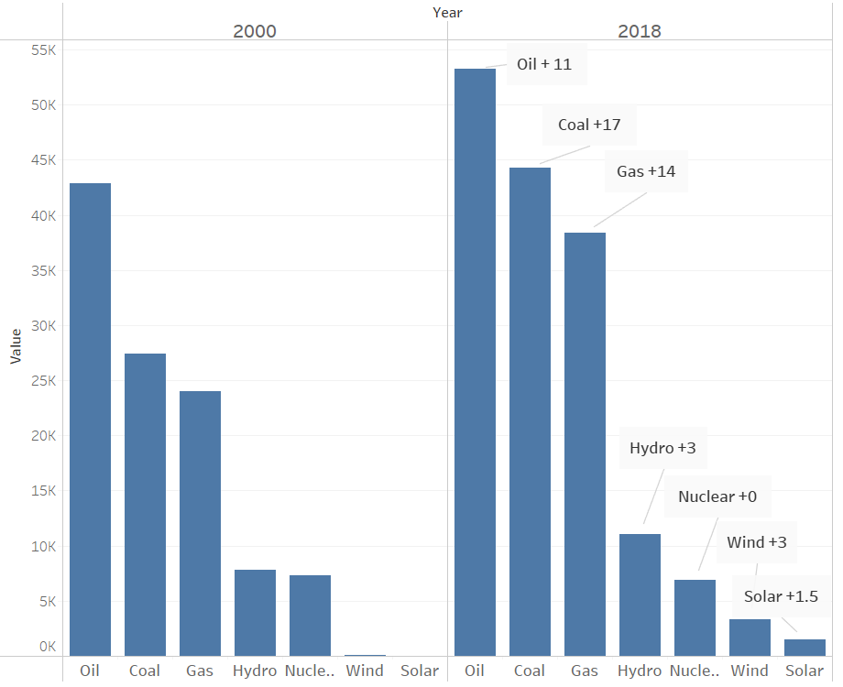
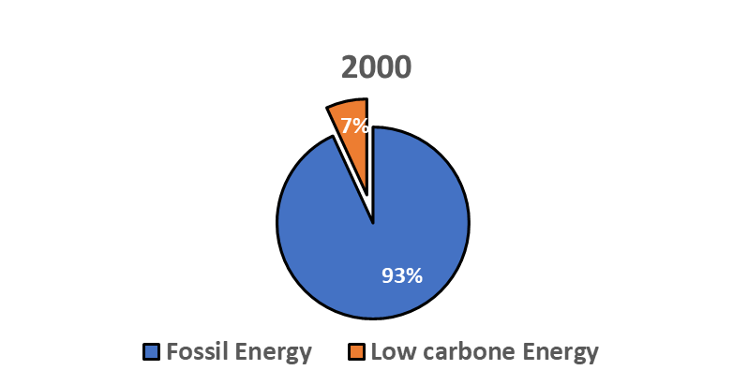
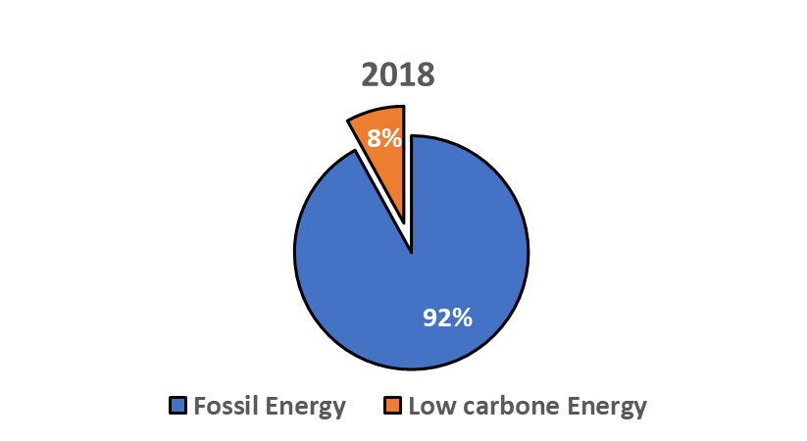
Data Vizualisation & Analysis
Energy source from 2000 to 2018 (in eq. TWH)
Share of Energy source

Slide 14
Conclusion & Future prospects
Main takeaway
  Coal is the main source of C02, followed by oil and both can explain 80% of the increase in C02 emissions
  Asia (China in top) is by far the main responsable
  There will be no global decline in C02 emissions in the near future
Future prospects :
  In 2022, nearly 200 (+12% of existing) coal-fired power stations are under construction in Asia:
    95 in China
    28 in India
    23 in Indonesia,
  Asian governments say coal needed for economic growth
  COP26 host wanted end-of-coal deal: China and India extend deadline
Source :
  the Helsinki-based Center for Research on Energy and Clean Air (CREA).
  https://www.reuters.com/business/energy/cop26-aims-banish-coal-asia-is-building-hundreds-power-plants-burn-it-2021-10-29/

Slide 15
Further Analysis

Slide 16
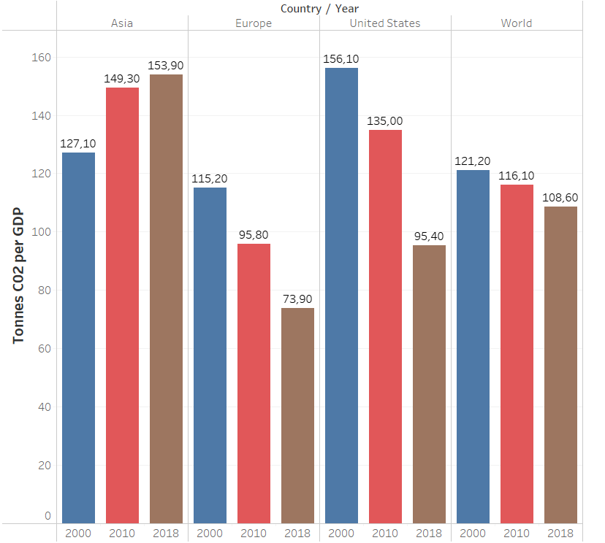
Data Vizualisation & Analysis
C02 Emissions per GDP in Asia/Europe/USA in 2000/2020/2018
C02 EMISSIONS per GDP
 | Value | Trend
Asia | +++ | +
Europe | ++ | - - -
Usa | +++ | - - -
World | ++ | -

